Slide 1

Composition
CMPS 251
Read Chapter 8
Unit 4

Slide 2
Composition
Sometimes you want an attribute of one class to be an object
Embedding one class inside another is called composition
We call this the has a relationship
Examples:
Car has an Engine (Car is a class; Engine is also a class)
Account has an Owner
BookStore has a Book (or books)

Slide 3
Composition Class Definition
public class Book {
private String title;
public Book(String title) {
this.title = title;
}
// getters and setters
public String getTitle() {
return title;
}
public void setTitle(String title) {
this.title = title;
}
}
<Book>
<String>
title
v
Composition!
<BookStore>
public class BookStore {
private String name;
private Book bestSeller;
public BookStore(String name, Book bestSeller) {
this.name = name;
this.bestSeller = bestSeller;
}
}
<String>
name
v
<Book>
bestSeller
<String>
title
v

Slide 4
Referencing After Instantiation
public class App {
public App() {
Book orgBook = new Book("Hunger Games");
BookStore orgStore = new BookStore("Jarir", orgBook);
}
}
orgStore <BookStore>
orgBook <Book>
<BookStore>
<Book>
<String>
<String>
title
"Hunger Games"
name
"Jarir"
<Book>
Reference
bestSeller
4

Slide 5
Objects and References
Once a class is defined, you can declare variables (object reference) of that type
Book book1, book2;
BookStore store1;
Author author1;
Object references are initially null
The null is a special value in Java indicating that the object is NOT created yet
The new operator is required to create the object
ClassName variableName = new ClassName();
Notes:
A primitive data type (e.g., int) cannot be casted to an object (e.g., String), but there are some conversion wrappers

Slide 6
Comparing objects (using ==)
public class App {
public App() {
Book orgBook = new Book("Hunger Games");
BookStore orgStore = new BookStore("Jarir", orgBook);
Book copybook = new Book(“Hunger Games”);
BookStore copyStore = new BookStore(“Jarir”, copybook);
if (orgStore == copyStore)
{
System.out.println(“They have the same values”);
}
}
}
Will this line work?
6

Slide 7
The solution to the == problem?
Define an equalsTo method
public class Book {
…..
public boolean equalsTo(Book book) {
return this.title.equals(book.title);
}
}
Two Books are equal if their title values are the same.

Slide 8
Code Deconstructed <equalsTo method>
Book book1 = new Book(“Alf Laila wa Laila”);
Book book2 = new Book(“Alf Laila wa Laila”);
if (book1 == book2)
System.out.println("Both variables refer to the same object");
else
System.out.println("Each variable refers to a different object");
if ( book1.equalsTo(book2) )
System.out.println("Both objects have the same value");
else
System.out.println("Each object has a different value");
Can we use book2.equalsTo(book1) instead?

Slide 9
Question
What if we want to compare BookStores?
public class BookStore {
…..
public boolean equalsTo(BookStore bookStore) {
return this.name.equals(bookStore.name) &&
this.bestseller.equalsTo(bookStore.bestSeller);
}
}

Slide 10
Using ArrayList in composition
public class Book
{
private String title;
private String author;
Book(String title, String author){
this.title = title;
this.author = author;
}
public String getTitle() {
return title;
}
public void setTitle(String title) {
this.title = title;
}
public String getAuthor() {
return author;
}
public void setAuthor(String author) {
this.author = author;
}
public String toString() {
return String.format("Title : %s - Author : %s", getTitle(), getAuthor());
}
}

Slide 11
Using ArrayList in composition
import java.util.ArrayList;
public class Library
{
private ArrayList<Book> books;
Library () {
this.books = new ArrayList<>();
}
public void addBook(Book book) {
books.add(book);
}
public Book getBook(String bookTitle) {
for(Book book : books)
{
if (book.getTitle().equalsIgnoreCase(bookTitle))
return book;
}
return null;
}
public ArrayList<Book> getBooks(){
return books;
}
}

Slide 12
Using ArrayList in composition
import java.util.ArrayList;
public class LibraryUI {
public static void main (String[] args)
{
Library library = new Library();
// Creating the Objects of Book class.
Book book = new Book("Effective Java", "Joshua Bloch");
library.addBook(book);
book = new Book("Thinking in Java", "Bruce Eckel");
library.addBook(book);
book = new Book("Java: The Complete Reference", "Herbert Schildt");
library.addBook(book);
Book abook = library.getBook("Thinking in Java");
System.out.printf("%s is authored by %s \n", abook.getTitle(),
abook.getAuthor());
ArrayList<Book> books = library.getBooks();
for(Book b : books){
System.out.println(b);
}
}
}

Slide 13
Java Inner Classes
In Java, it is also possible to nest classes (a class within a class).
The purpose of nested classes is to group classes that belong together, which makes your code more readable and maintainable.
One advantage of inner classes, is that they can access attributes and methods of the outer class
To instantiate an inner class, you must first instantiate the outer class. Then, create the inner object within the outer object with this syntax:
OuterClass outerObject = new OuterClass();
OuterClass.InnerClass innerObject = outerObject.new InnerClass();

Slide 14
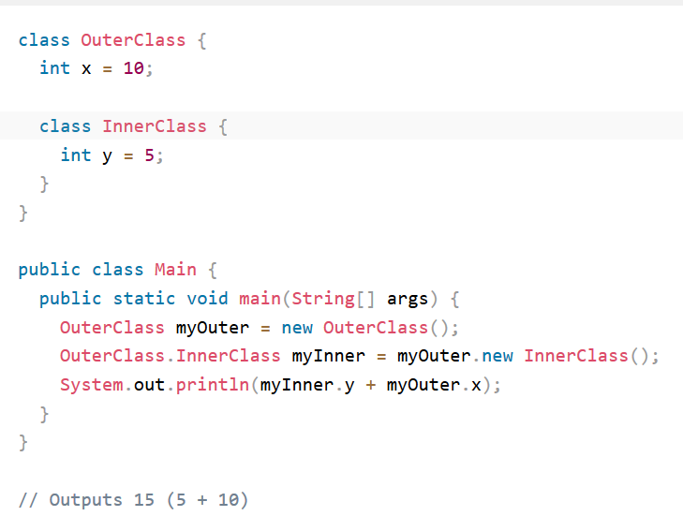
Java Inner Classes
To access the inner class, create an object of the outer class, and then create an object of the inner class:

Slide 15
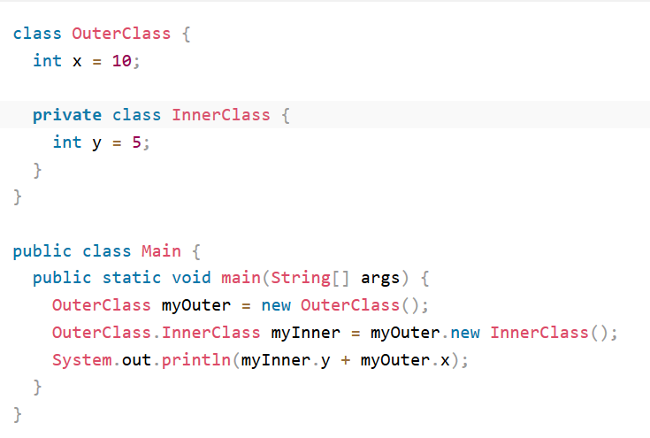
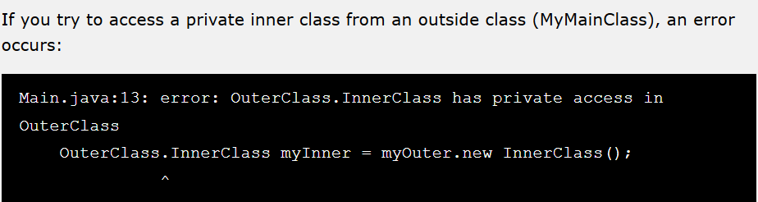
Private Inner Class
Unlike a "regular" class, an inner class can be private or protected. If you don't want outside objects to access the inner class, declare the class as private:

Slide 16
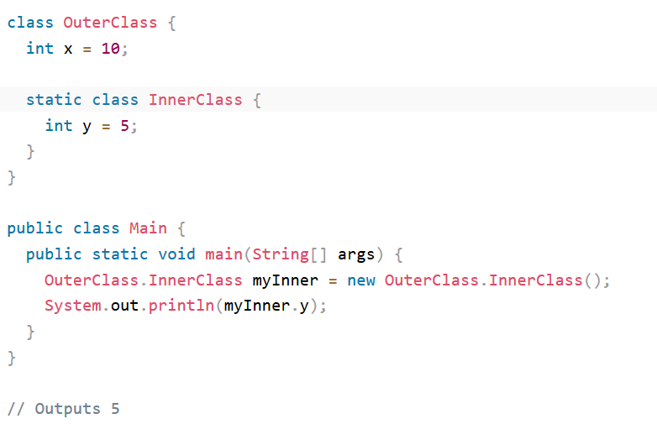
Static Inner Class
An inner class can also be static, which means that you can access it without creating an object of the outer class
Just like static attributes and methods, a static inner class does not have access to members of the outer class.
If you try to access a private inner class from an outside class (MyMainClass), an error occurs

Slide 17
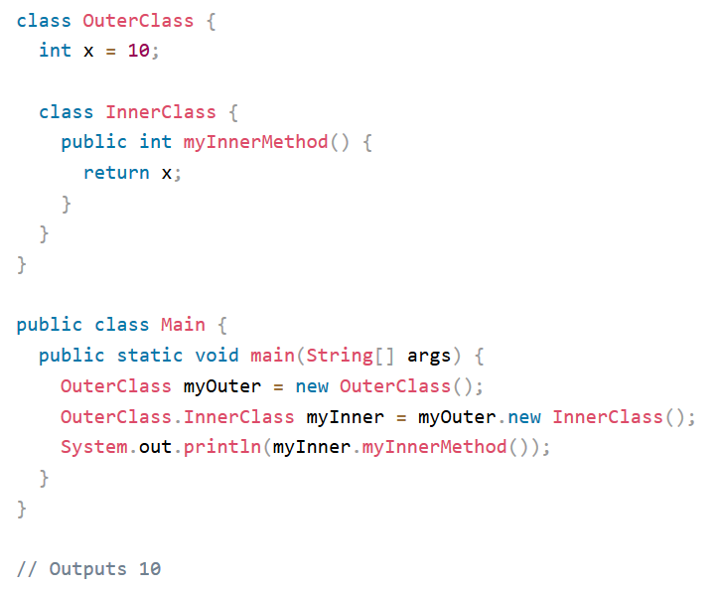
Access Outer Class From Inner Class
One advantage of inner classes, is that they can access attributes and methods of the outer class:

